Slide 1


JEPPIAAR ENGINEERING COLLEGE DEPARTMENT OF COMPUTER SCIENCE AND ENGINEERING FLIGHT BOOKING APPLICATION
TEAM LEADER : ABDULLA TIPPU SULTAN I (310821104001)
TEAM MEMBER - 1 :JOSHUA JARED JEBARAJ R (310821104041)
TEAM MEMBER - 2 : DINESH KUMAR S (310821104026)
TEAM MEMBER - 3 : GIFTSON JEBAZ P (310821104031)
SUPERVISOR NAME : MRS.D.JEEVITHA ,M.E ASSISTANT PROFESSOR /CSE

Slide 2
Team Members and Roles
Project Manager : Abdulla Tippu Sultan I
Frontend Developer : Dinesh Kumar S
Backend Developer : Joshua Jared Jebaraj R
Database Administrator : Giftson Jebaz P

Slide 3
Introduction
Purpose: To create a user-friendly web application for booking flights.
Objective: Streamline the process, ensure secure transactions, and provide compatibility across devices.

Slide 4
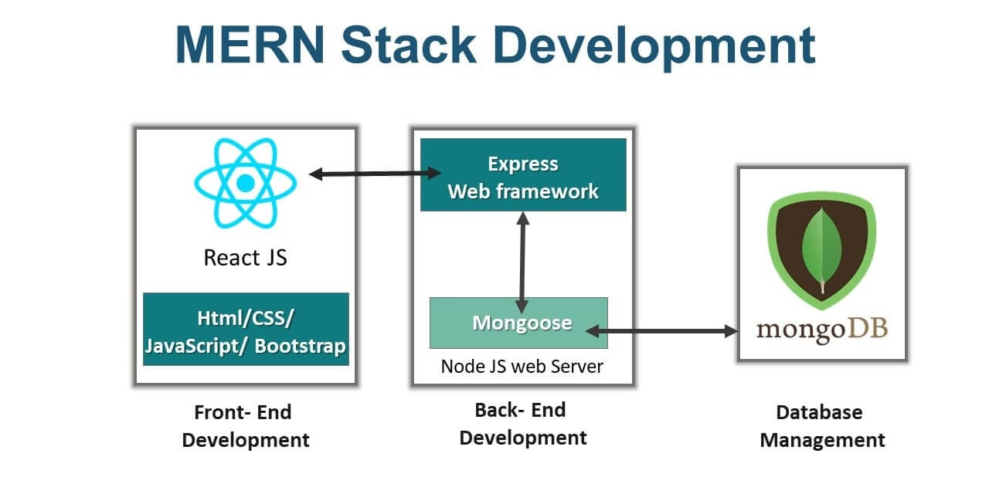
Architecture

Slide 5
Architecture - Overview
Three-Tier System: Presentation, Business Logic, and Data layers.
Frontend: React.js with Bootstrap for styling.
Backend: Node.js with Express.js for API handling.

Slide 6
Architecture - Details
Database: MongoDB for NoSQL storage and retrieval.
Security: Implemented with JSON Web Tokens (JWT).
Real-Time Updates: Powered by WebSockets and APIs.

Slide 7
FRONTEND
REACT.JS,HTML/CSS,BOOTSTRAP
BACKEND
NODE.JS,EXPRESS.JS,RESTFUL API’s
DATABASE
MONGODB

Slide 8
Setup Instructions - Prerequisites
Install Node.js and MongoDB.
Ensure npm is installed for dependency management.
Clone the repository from GitHub.

Slide 9
Overview - Features
Flight Search: Destination, departure date, price range, and airline preferences.
User Accounts: Save preferences and manage bookings.
Secure Payments: Integrate popular gateways for seamless transactions.

Slide 10
FRONTEND
Designing and implementing the User Interface (UI) for a seamless user experience (UX).Ensuring compatibility across devices with responsive layouts.
React.js is used to create dynamic and interactive UI components.HTML/CSS is used for structuring and styling the application.Bootstrap is used for consistent design and responsiveness.

Slide 11
BACKEND
Developing the server-side logic and APIs for smooth communication between the frontend and database.Implementing authentication and ensuring secure data exchange.
Node.js is used For handling server-side operations and running the backend logic.Express.js is used to manage HTTP routing and middleware.
/api/flights for retrieving flight options.POST /api/bookings for making secure bookings.GET /api/users/{id} for fetching user-specific data.JWT

Slide 12
DATABASE
Designing and managing the database structure for optimal data storage and retrieval.Ensuring data security and integrity.
MongoDB is a NoSQL database chosen for its flexibility in storing unstructured data.

Slide 13
Overview - Features Continued
Real-time Updates: Notifications for flight delays, cancellations, and price drops.
Responsive Design: Compatibility across various devices.
Seamless Navigation: Intuitive UI/UX.

Slide 14
Authentication
In the Flight Booking App, authentication plays a key role in securing user data and ensuring that only authorized users can access specific functionalities like booking flights, viewing personal data, and managing account settings.
User Registration
User Login
JWT Authentication
Role-Based Access Control (RBAC)
User Logout Password Reset
Two-Factor Authentication (Optional)

Slide 15
Setup Instructions - Steps
1. Install Dependencies: npm install in the root directory.
2. Configure Environment: Set up .env file.
3. Run Application: Start both frontend and backend servers.

Slide 16
Running the Application
Frontend: Navigate to client directory and run npm start.
Backend: Navigate to server directory and run npm start.
Access the application locally on http://localhost.

Slide 17
Features
Search by: Destination, date, price range, and airline preferences.
Secure Login: Encrypted passwords with JWT authentication
Encryption: Ensure safe data handling during payments.
Popular Payment Gateways: Seamless transaction experience.

Slide 18
Features - Real-time Updates
Notifications: Alerts for delays, cancellations, and price drops.
Live Updates: Dynamic flight schedules.

Slide 19
Testing - Overview
Unit Testing: Individual components (APIs, UI forms).
Integration Testing: Backend-frontend data flow.
End-to-End Testing: Full application workflow.

Slide 20
Testing - Unit Testing
APIs: Validate endpoints for data accuracy.
UI: Test forms and individual frontend elements.
Libraries: Use Jest or Mocha for tests.

Slide 21
Testing - Integration Testing
Data Flow: Ensure seamless interaction between modules.
Database Queries: Validate CRUD operations.
Tools: Postman, automated scripts.

Slide 22
Testing - End-to-End Testing
Workflow Validation: User sign-up to booking confirmation.
Tools: Cypress or Playwright.
Automation: Scripted test cases for efficiency.

Slide 23
Future Enhancements - Overview
Real-Time Flight Data: Integration with airline APIs.
Global Reach: Multi-language interface support.
Advanced Suggestions: AI-powered flight recommendations.

Slide 24
Future Enhancements - Real-Time Data
Live Updates: Sync schedules with airline databases.
Dynamic Pricing: Reflect price changes in real-time.
Collaborations: Establish partnerships with airline providers.

Slide 25
Future Enhancements - AI Recommendations
User Analysis: Suggest flights based on preferences.
Personalization: Improve user experience through smart insights.
Efficiency: Reduce time spent searching for flights.

Slide 26
Screenshots and Visuals
Homepage: Highlight search functionality and featured deals.
Flight Search Results: Display filtering options.
Booking Confirmation: Show payment and ticket details.

Slide 27
Known Issues
API Limitation: No real-time flight data.
Mobile Optimization: Minor issues on older devices.
Responsive Design: Ensure compatibility improvements.

Slide 28
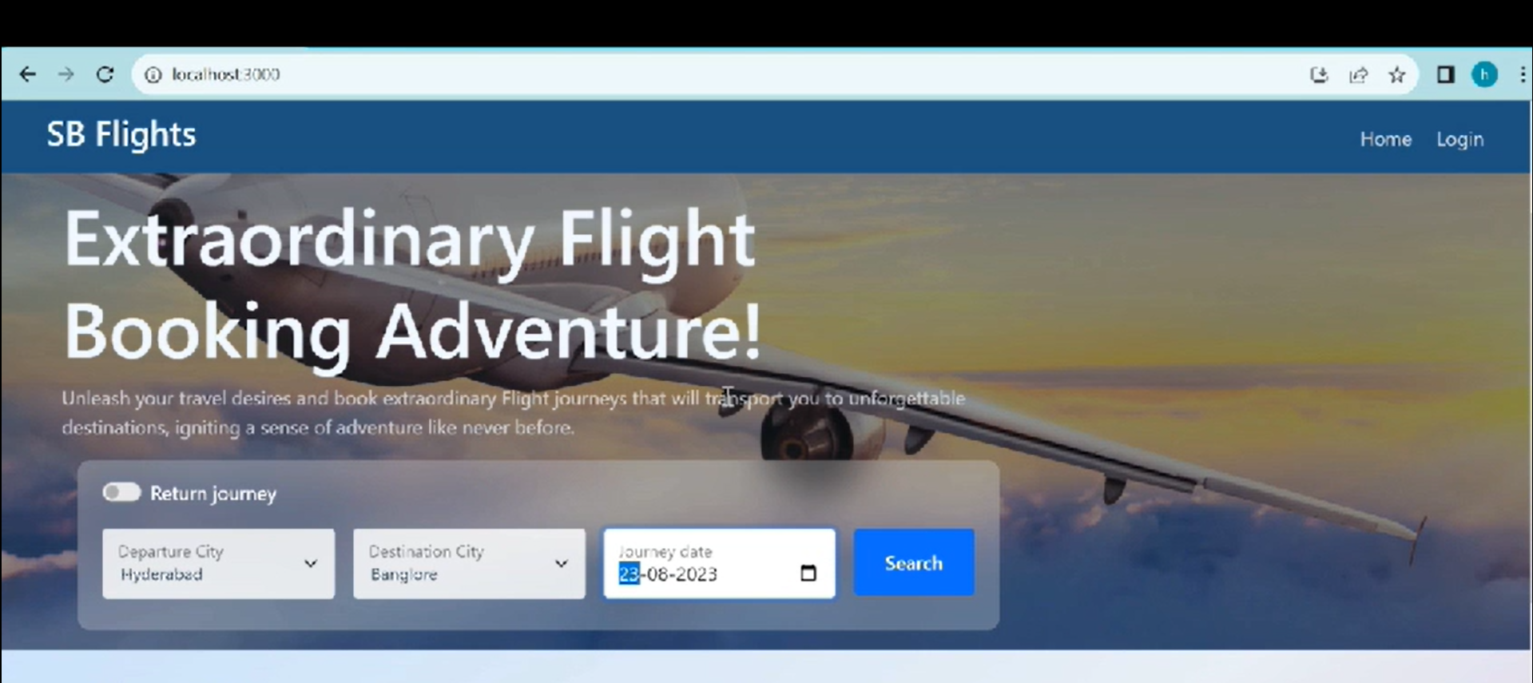
Screenshots
Home page

Slide 29
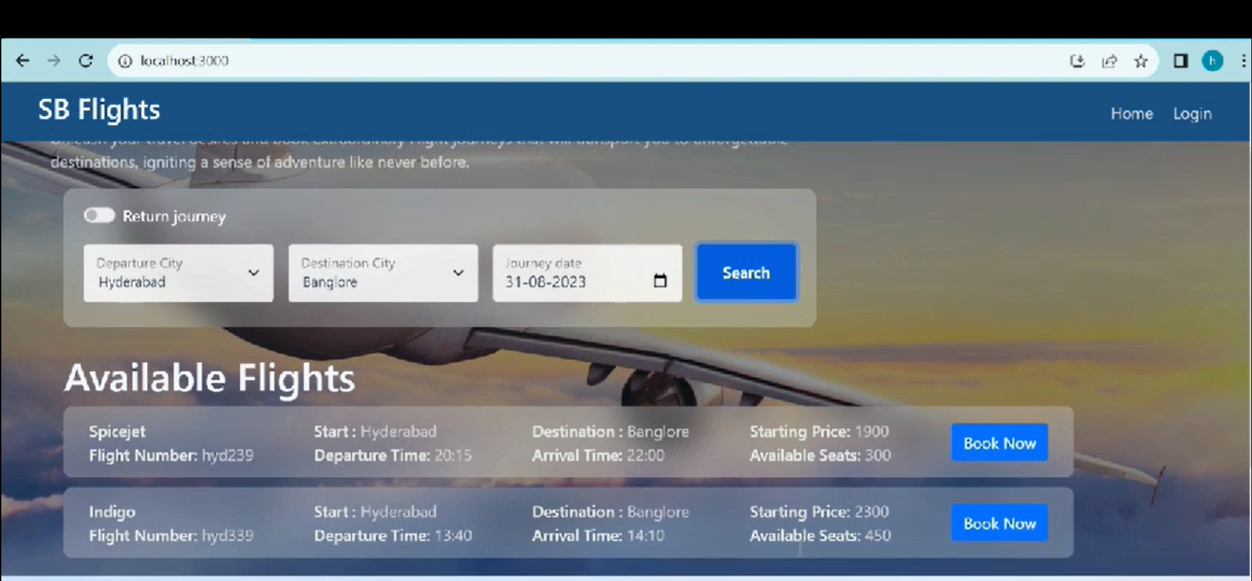
Flight Availability checking page

Slide 30
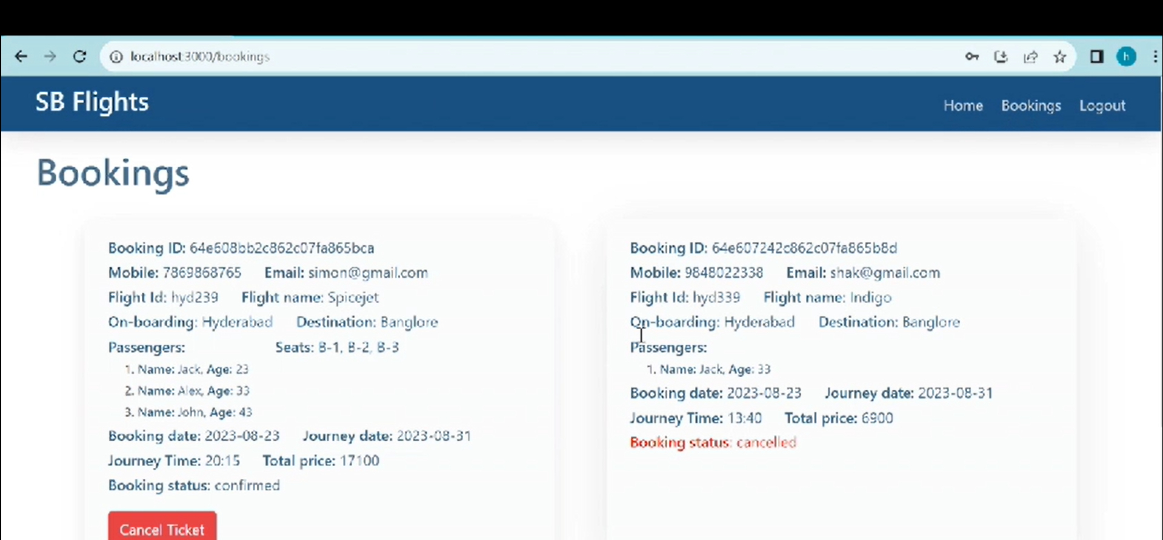
Flight Booking Page

Slide 31
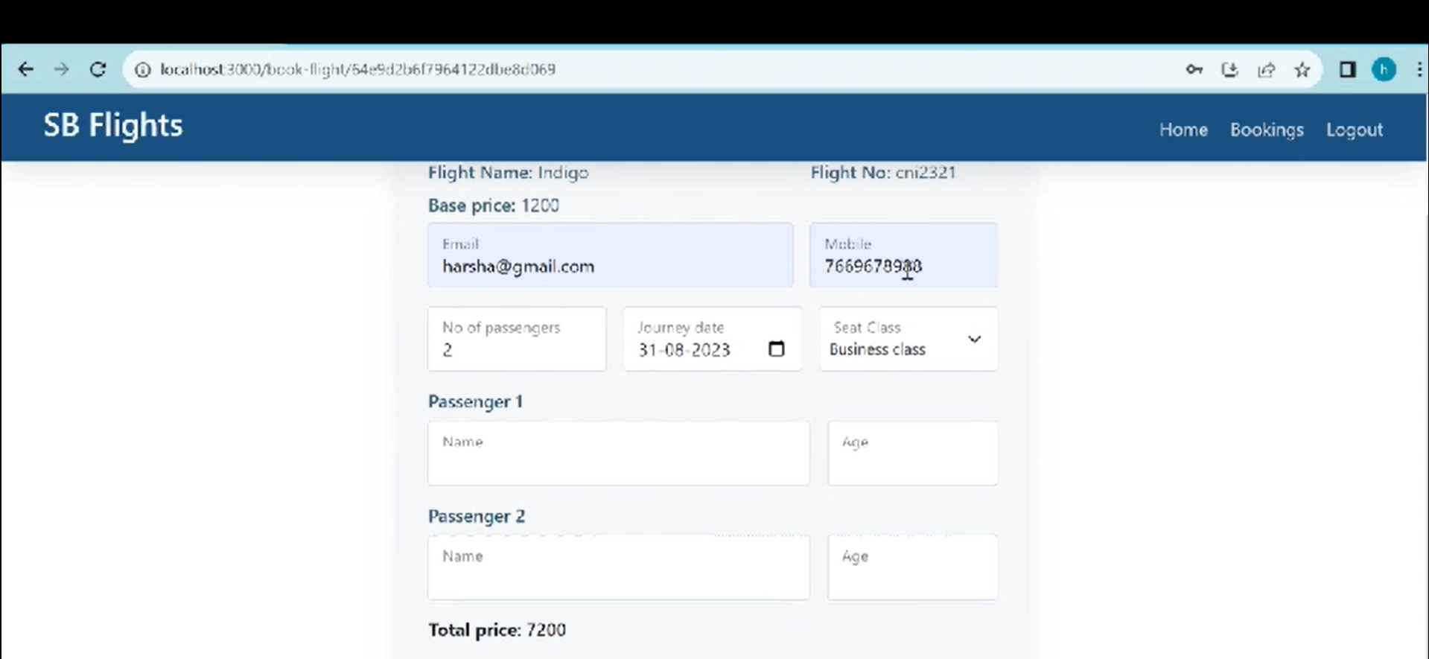
Details Filling Page

Slide 32
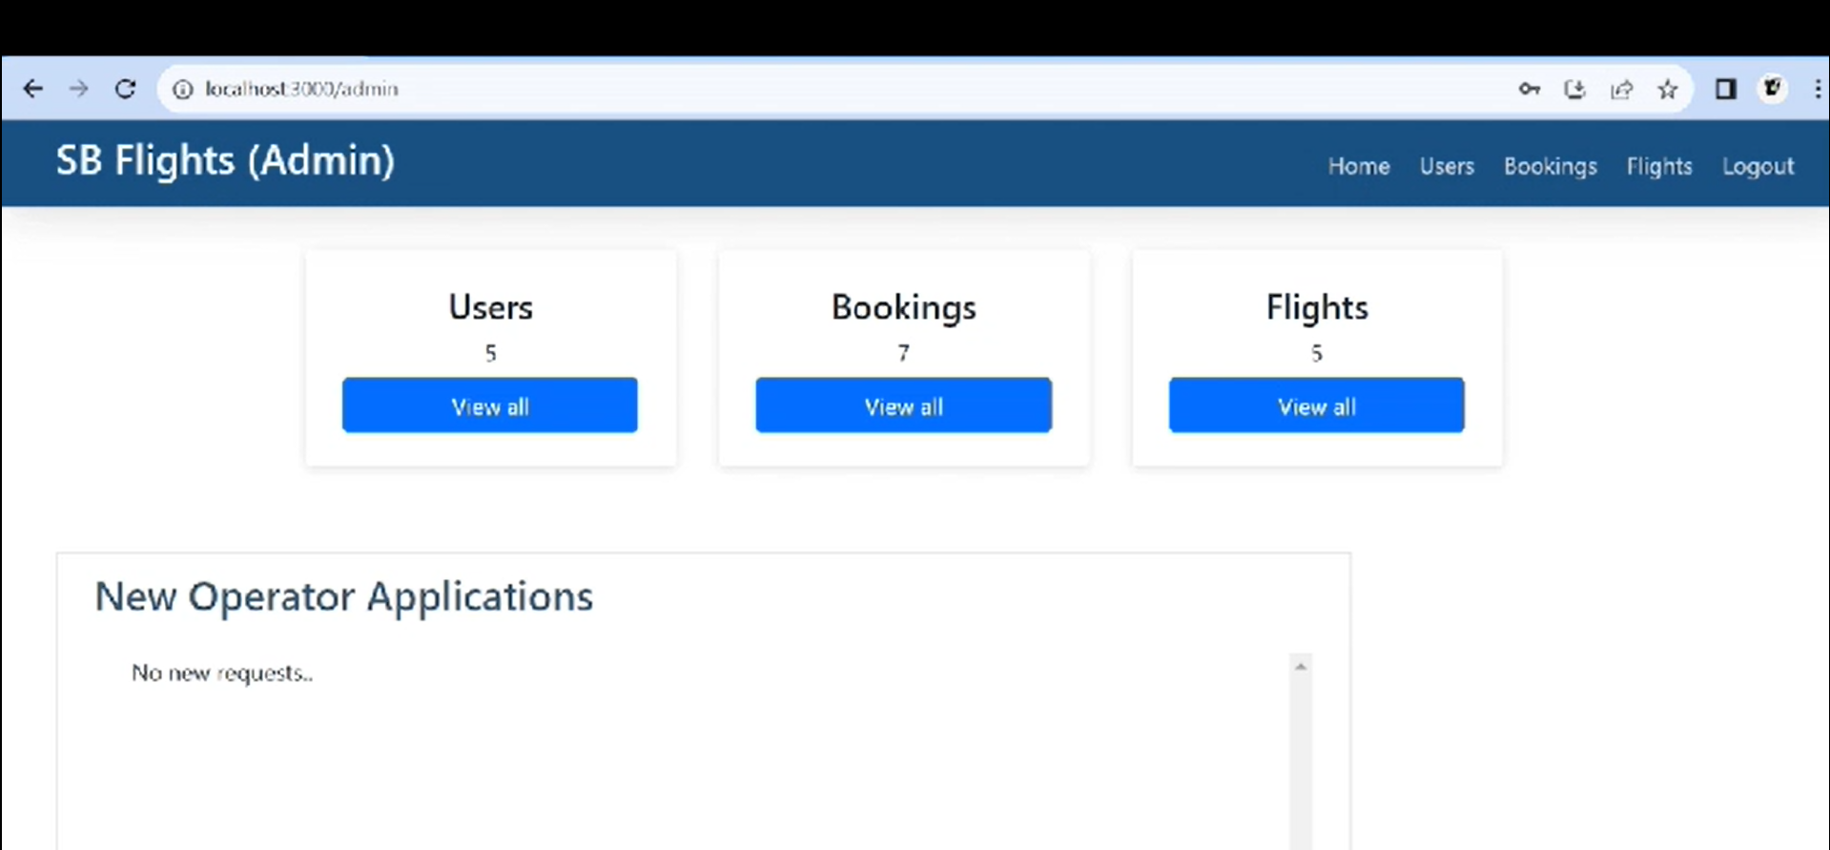
Admin Page

Slide 33
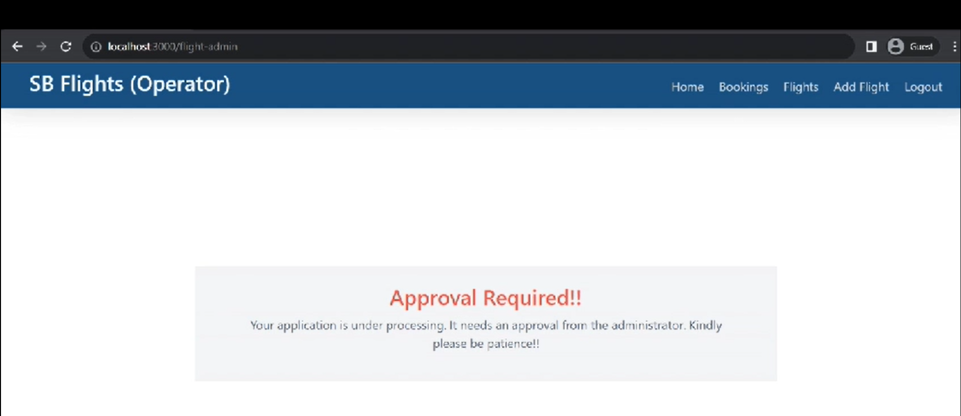
Loading Page

Slide 34
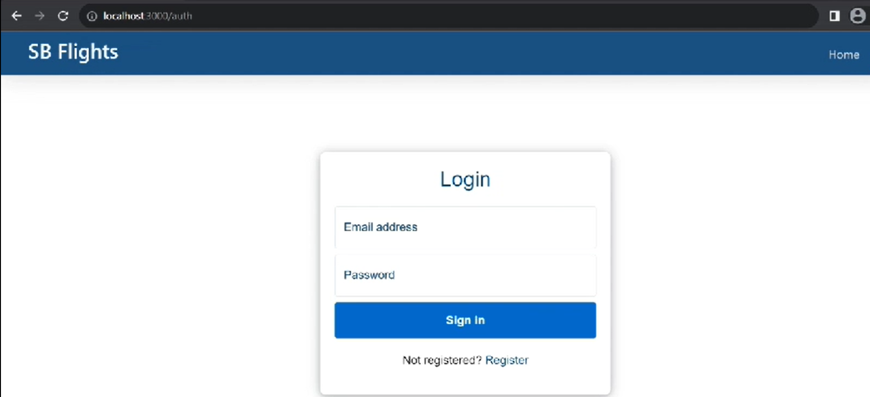
User Login Page

Slide 35
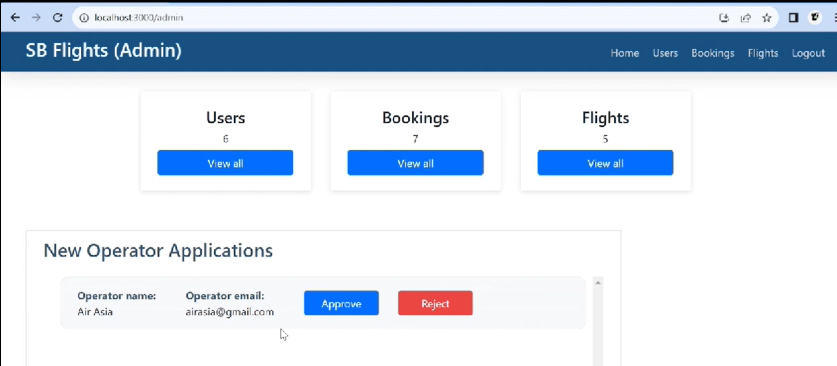
Application Approval Page

Slide 36
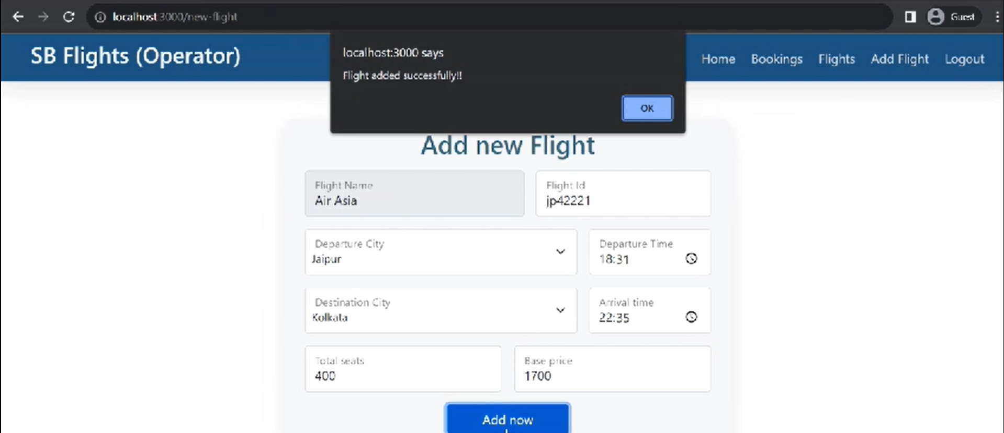
Notification Page

Slide 37
Conclusion
Simplified Booking: User-centric design for easy navigation.
Scalable Architecture: Support future expansions.
Reliable and Secure: Prioritizing user data security.

Slide 38
Thank You!

